Slide 1
Unit-4
…continued

Slide 2
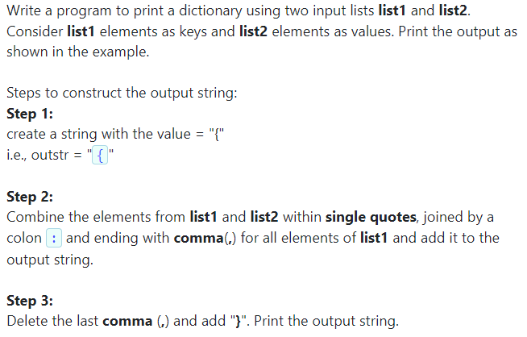
Problem statement(5.5)

Slide 3
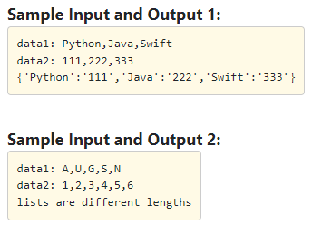

Slide 4
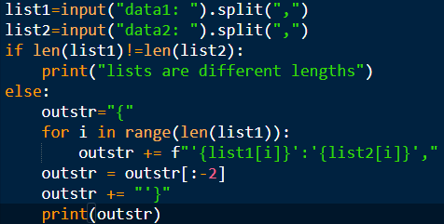
Contd…

Slide 5
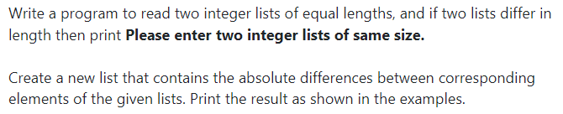
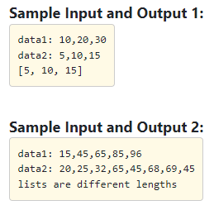
Problem statement (5.6)

Slide 6
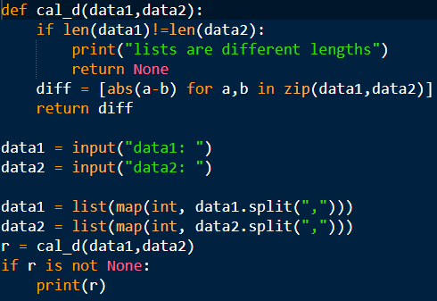
Contd…

Slide 7
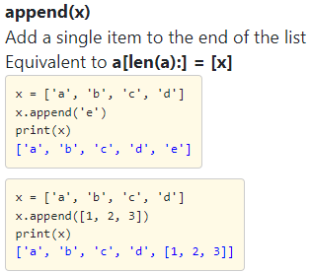
List methods

Slide 8
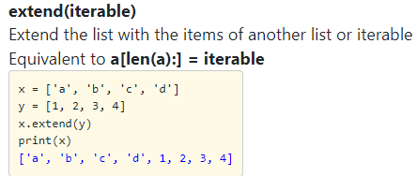
Contd…

Slide 9
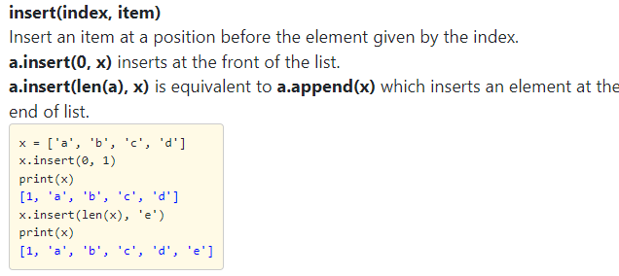
Contd…

Slide 10
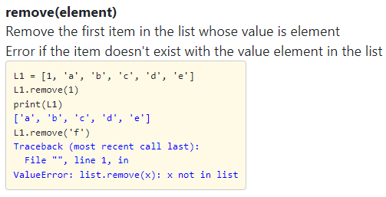
Contd…

Slide 11
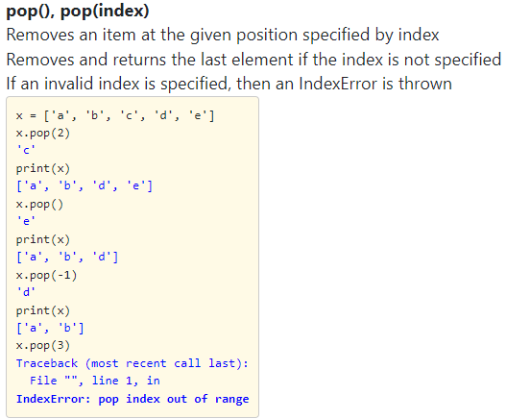
Contd…

Slide 12
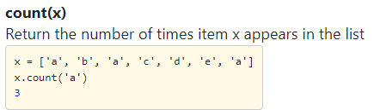
Contd…

Slide 13
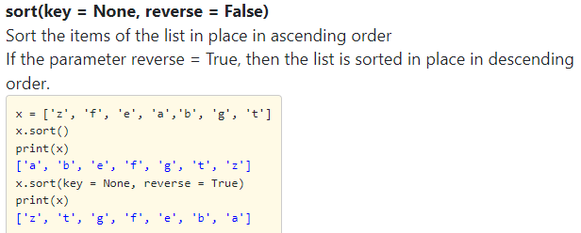
Contd…

Slide 14
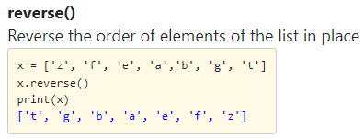
Contd…

Slide 15
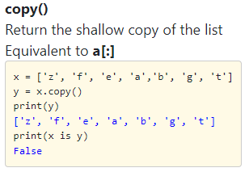
Contd…

Slide 16
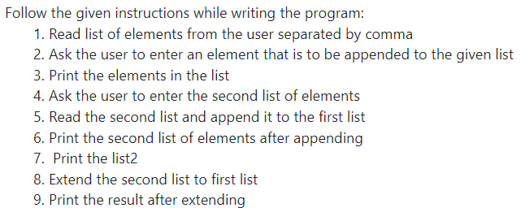
Problem statement(6.1)

Slide 17
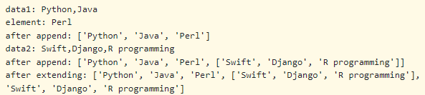
Contd… Sample Input & Output

Slide 18
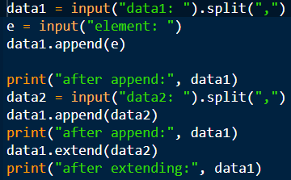
Contd…

Slide 19
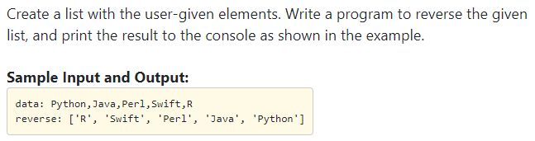
Problem statement(6.2)

Slide 20

Contd…

Slide 21
[::-1] is a slicing notation. In this case, [::-1] specifies a slice that goes from the beginning of the sequence to the end, but with a step of -1.
The step of -1 in the slice effectively reverses the order of elements in the sequence.

Slide 22
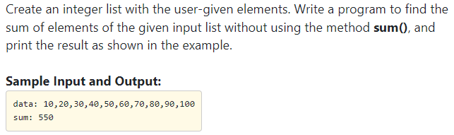
Problem statement (6.4)

Slide 23
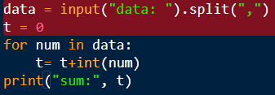
contd…

Slide 24
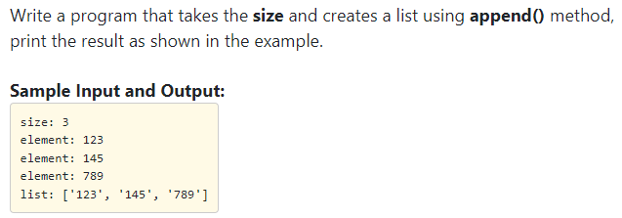
Problem statement (6.11)

Slide 25
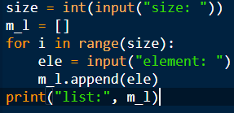
Contd…

Slide 26
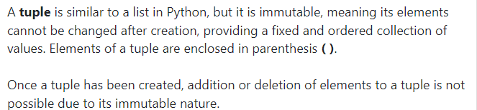
Introduction to Tuple

Slide 27
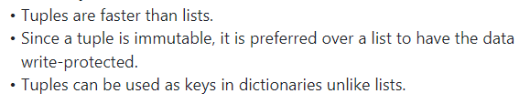
Benefits of Tuple

Slide 28
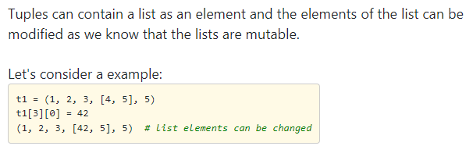
Contd…

Slide 29
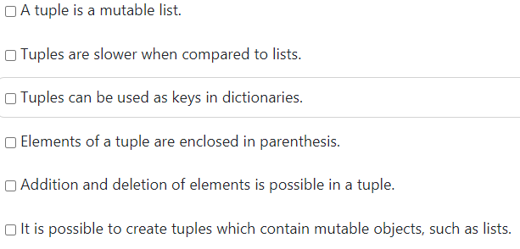
Select the correct statements

Slide 30
Option3,4&6 are correct.

Slide 31
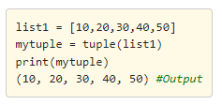
Example: To convert list of elements in to a tuple

Slide 32
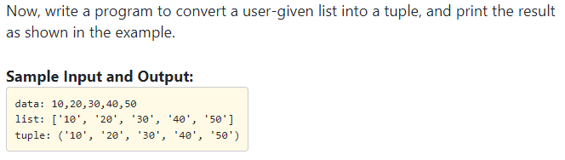
Problem statement(7.3)

Slide 33
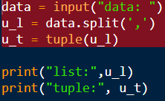
Contd…

Slide 34
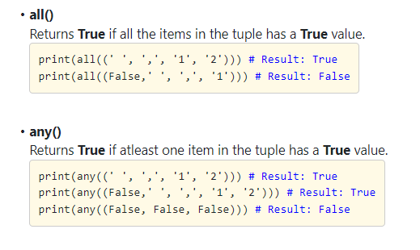
Built-in Tuple functions

Slide 35
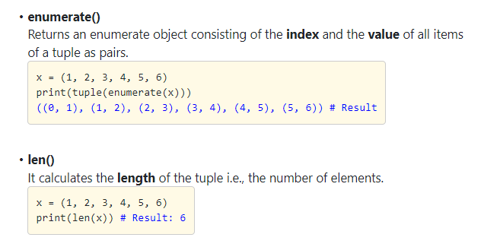
Contd…

Slide 36
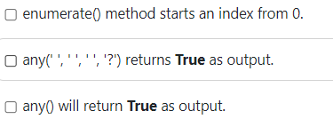
Select the correct statement

Slide 37
Option 1 & 2 is correct.

Slide 38
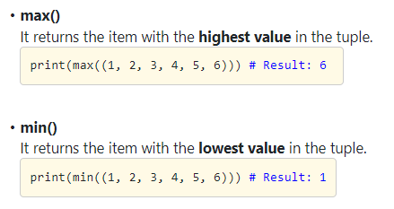
Built-In Tuple Functions

Slide 39
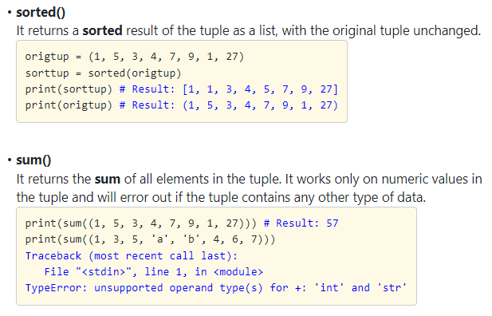
Contd…

Slide 40
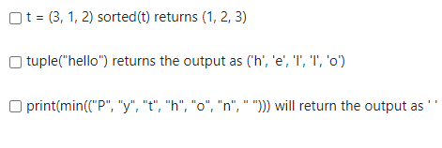
Select the correct statements:

Slide 41
Options 2&3 are true

Slide 42
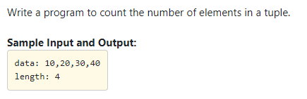
Problem statement(8.3)

Slide 43
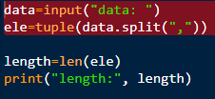

Slide 44
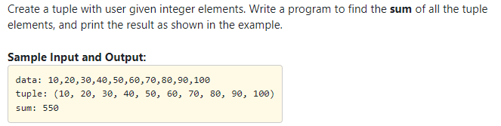
Problem statement (8.5)

Slide 45
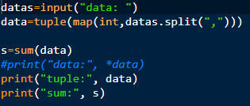

Slide 46
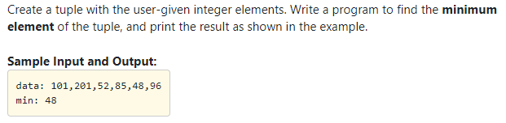
Problem statement(8.7)

Slide 47


Slide 48
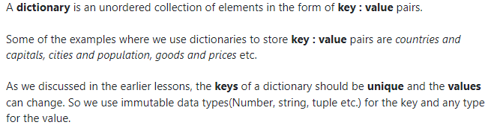
Introduction to Dictionaries

Slide 49
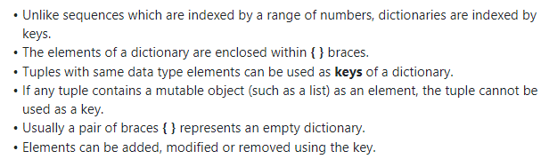
Contd…

Slide 50
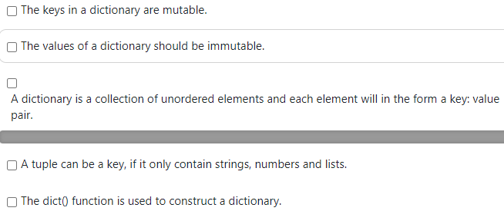
Select the correct statement

Slide 51
Option 3&5 are correct.

Slide 52
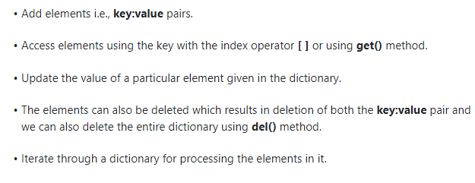
Overview of Operations on Dictionary

Slide 53
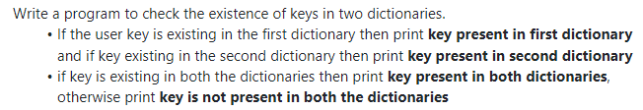
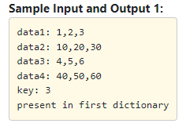
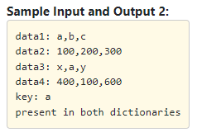
Problem statement(10.6)

Slide 54
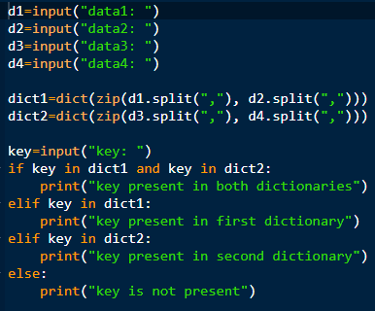

Slide 55
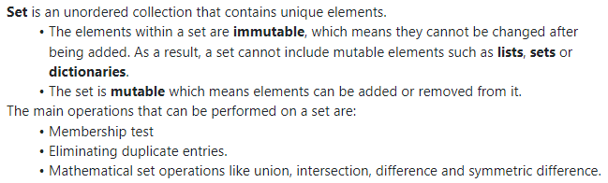
Introduction to Sets

Slide 56

Contd…

